Slide 1
A Sustainable Planet
Week 5
Formation of mineral resources
Dr Vicky Coker
Department of Earth and Environmental Sciences
vicky.coker@manchester.ac.uk; Williamson Building

Slide 2
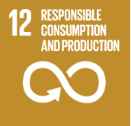

Learning outcomes
Understand the necessity of mining metals
Explain how geological processes lead to ore deposit formation
Identify some key geological settings for ore deposits
Explain the mineralogy of some key ore deposits
Explain how some key metals are refined
Explain critical minerals and their supply risks
2024 status: Stagnation
2024 status: Stagnation

Slide 3
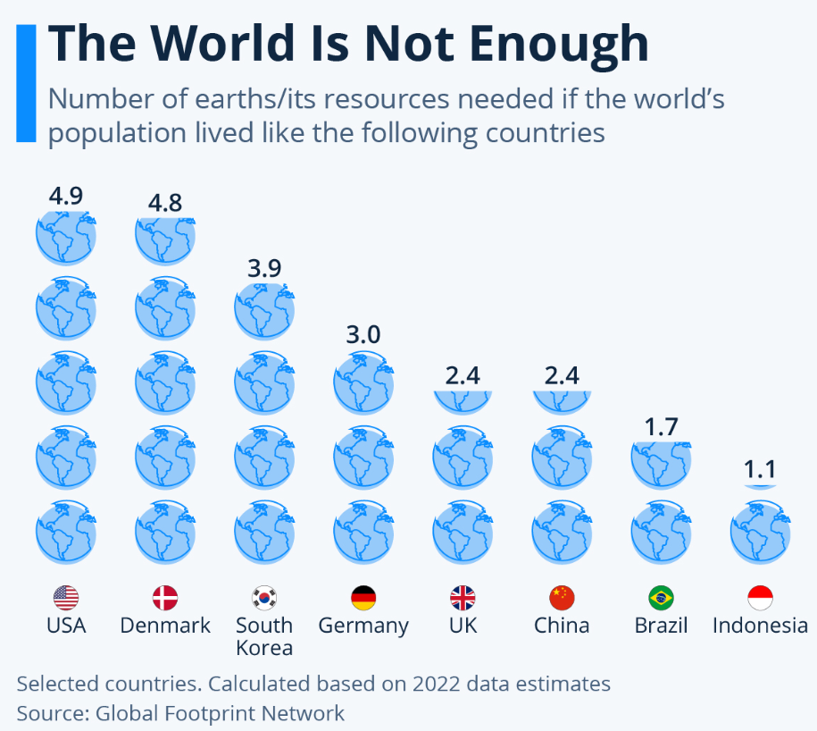

Slide 4
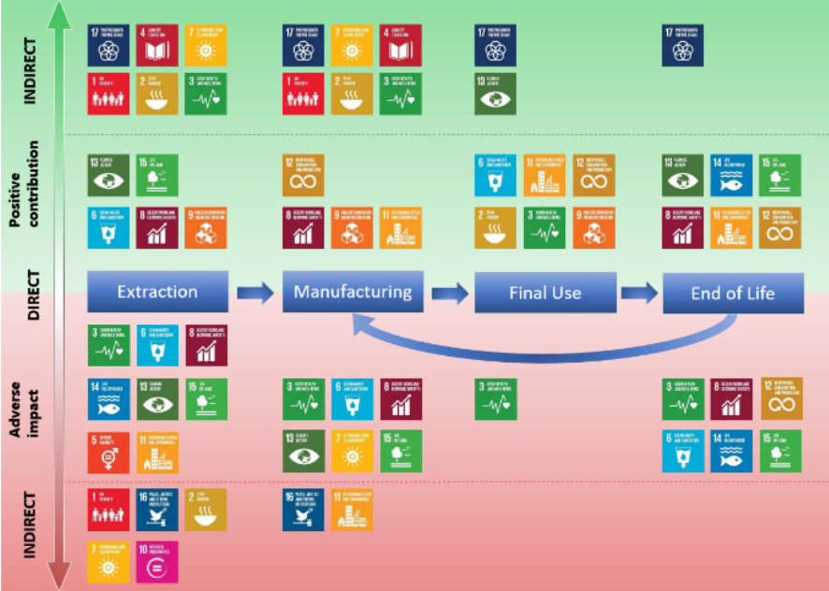
Contributions of raw materials to SDGs
European Commission: Joint Research Centre, Grassi, G., Mancini, L., Vizzarri, M., Wittmer, D. et al., Mapping the role of raw materials in sustainable development goals – A preliminary analysis of links, monitoring indicators and related policy initiatives, Publications Office, 2019, https://data.europa.eu/doi/10.2760/026725

Slide 5
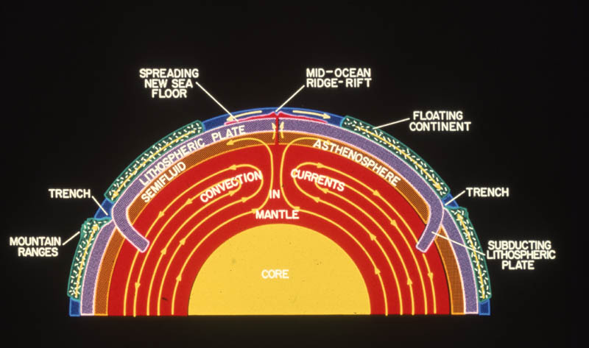
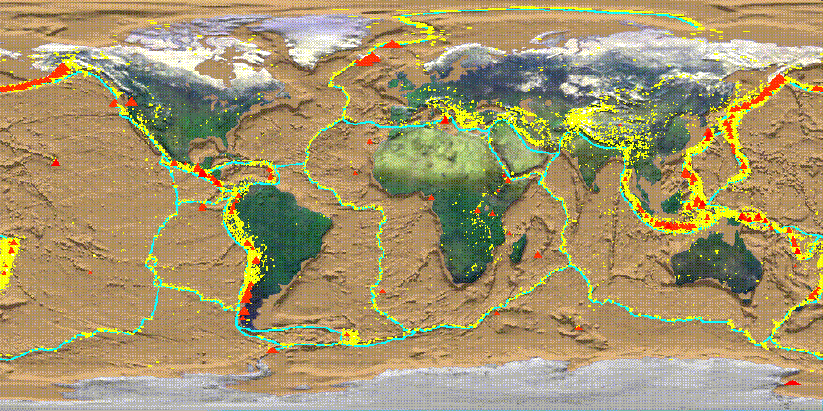
Plate tectonics and resources
Lithospheric plates move due to mantle convection
Convergent and divergent plate boundaries lead to differing deposits of earths resources
Particularly:
  Mid-Ocean-Ridges
  Subduction Zones

Slide 6
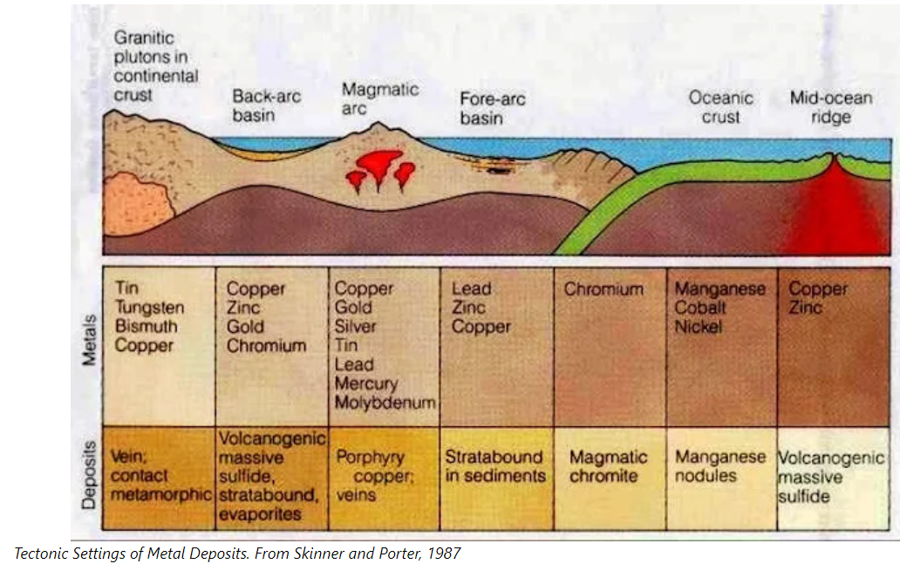
Tectonic Environments

Slide 7
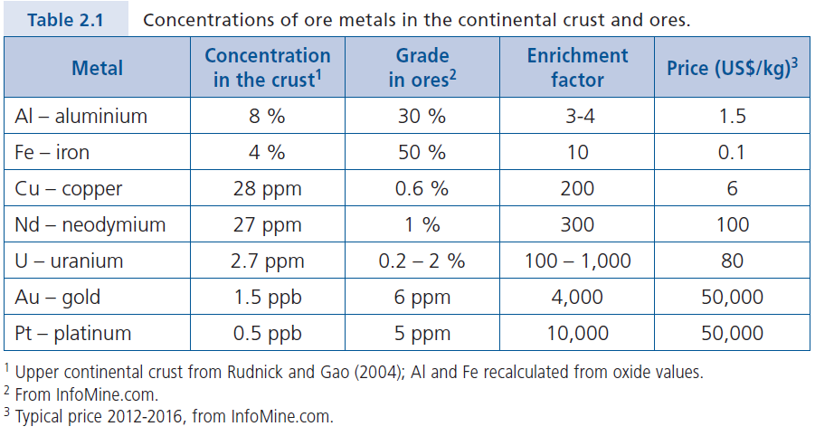
Processes of Ore Formation
Enrichment of OFEs (ore forming elements) above background concentrations
Geochemical Perspectives, vol. 6, p18

Slide 8
Ore Formation
– Precipitation from Mobile Fluids
Source
  Selective extraction from source rock into a mobile phase
Transport
  Transport to the site of deposition
Deposition/precipitation
  Ore minerals precipitated into a comparatively small volume of rock

Slide 9
Aqueous Fluids
Most important ore-forming fluid
  Capacity for solubilising metals
  Capacity for transporting Ore Forming Elements & heat
  Precipitate metals in response to chemical gradients
    T (temperature)
    P (pressure)
    X (fluid composition)
  Often through acid/base or redox reactions

Slide 10
Ore Forming Fluids
Ni-Cu Sulfides
Rock melts
Aqueous fluids
  Magmatic exhalations
  Regional metamorphic fluids
  Meteoric hydrothermal fluids
  Surface/near surface waters
Mafic Fe-Ti
Porphyry Coppers
Skarns
Archean Gold Lode Deposits
Volcanic Massive Sulfides
Deposits
Mississippi Valley Type
Deposits
Precambrian BIF Deposits
Sandstone-hosted uranium

Slide 11
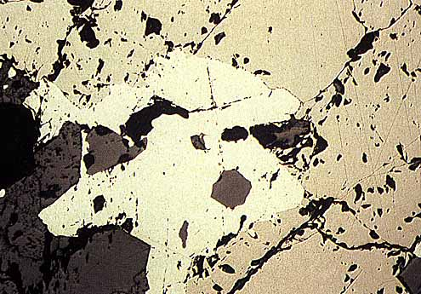
Many common rocks contain significant amounts of “abundant metals” but only a few are rich enough to be mined as “ores”
Note: Factors important are:
mineralogy
grade
grain size/texture
size and depth of deposit
geographic location
possible by-products
Mineralogy and grade are particularly important: only some minerals are rich enough in the metal to be “ore minerals”
Mineralogy, grain size, texture influence process methods/costs
e.g.: Iron easier to remove from Fe₂O₃ than from Fe₂SiO₄
Size/depth/geographic location influence mining and transport costs
By-products can add to value

Slide 12
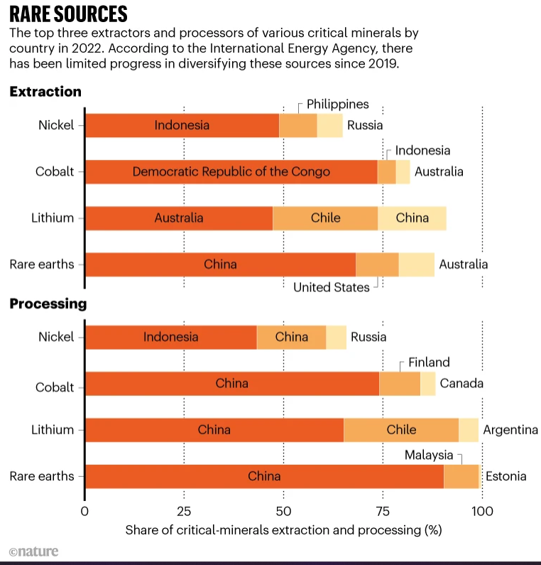
Critical materials
Availability
Production as a by-product
Demand
Low substitutability
Virtually no recycling
High supply risk

Slide 13
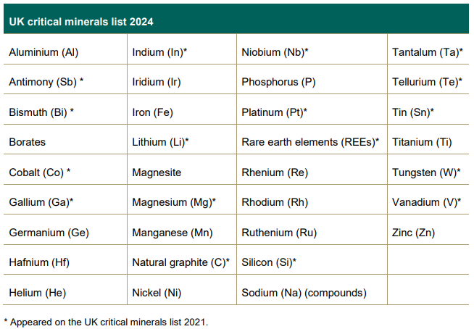
UK critical minerals 2024
UK 2024 criticality assessment
Notes:
UK 2024 criticality assessment

Slide 14
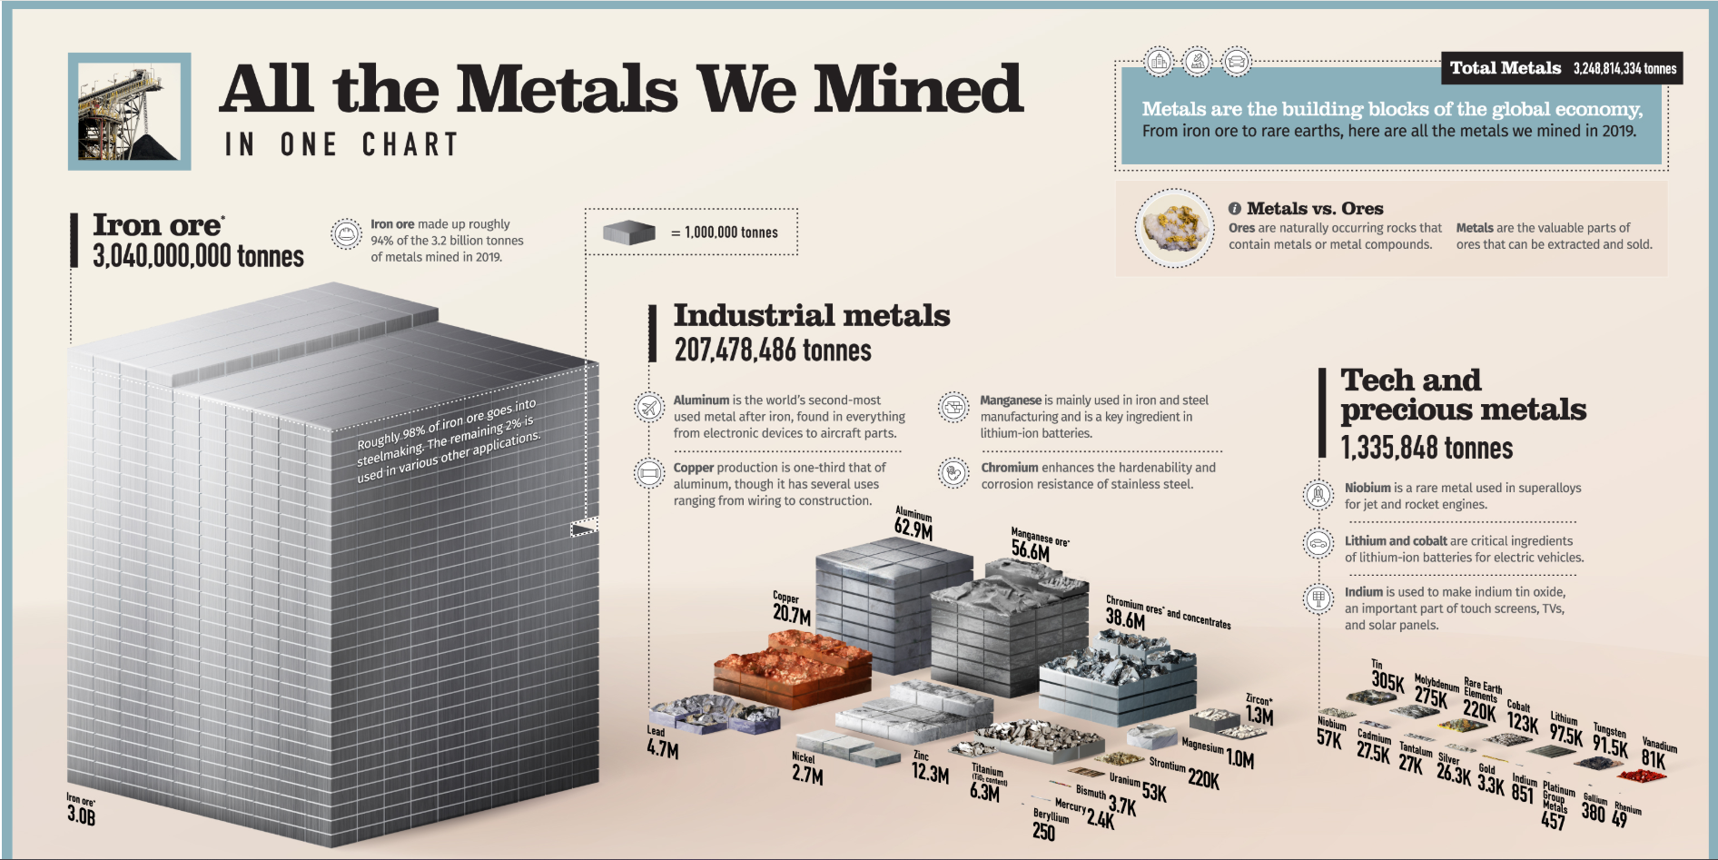

Slide 15
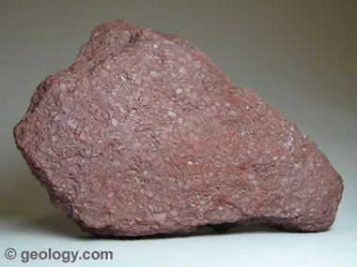
Iron

Slide 16
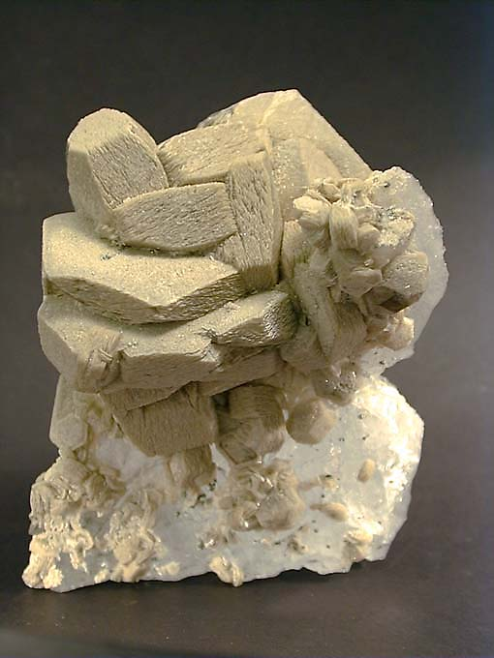
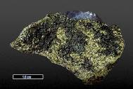
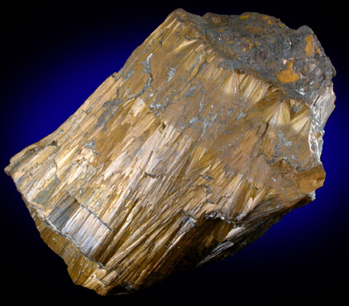
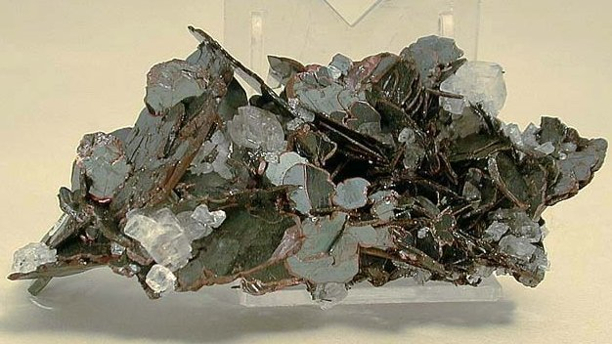
Mineralogy dominated by iron in two oxidation states
FERROUS (Fe²⁺⁾:
relatively soluble
forms minerals such as:
Siderite (FeCO₃)
Chamosite (Fe(Si,Al)₂O₅(OH)₄)
Chamosite
Siderite
FERRIC (Fe³⁺⁾:
relatively insoluble
forms minerals such as:
Hematite (Fe₂O₃)
Goethite (FeOOH)
Goethite
Hematite
Iron Deposits can form through igneous, metamorphic or sedimentary processes

Slide 17
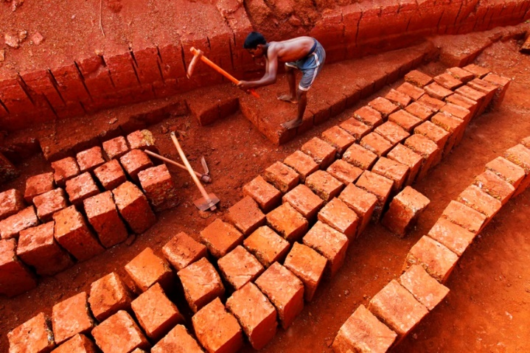
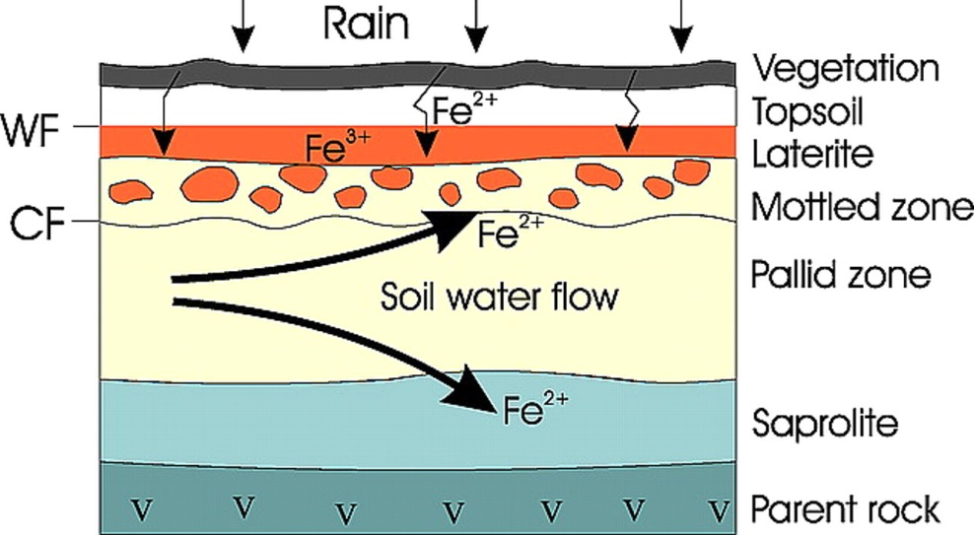
Residual Deposits-Laterite formation
Soils rich in Fe that form in hot, wet subtropical and tropical environments
Laterite –source of iron and nickel
Created through weathering a soil under strong oxidising and leaching conditions
Chemical weathering removes the more soluble material and leaves Fe hydroxides -Fe(OH)₃
Laterite-can be used as a building material
Laterite formation

Slide 18
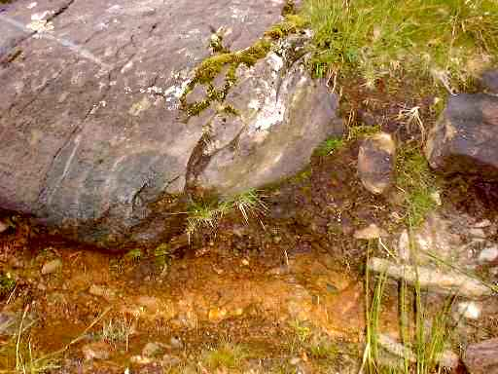
Sedimentary Deposits
Three types:
1) Bog Iron Deposits
Small, no longer mined but historically important
Fe mobilised as Fe²⁺ in swamps (“bogs”)
Transported in organic–rich near–surface waters
Enter oxygen–rich lake (or coastal waters) oxidize to Fe³⁺ and precipitate
Ore: Goethite (FeOOH) and magnetite (Fe₃O₄)

Slide 19
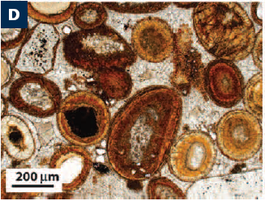
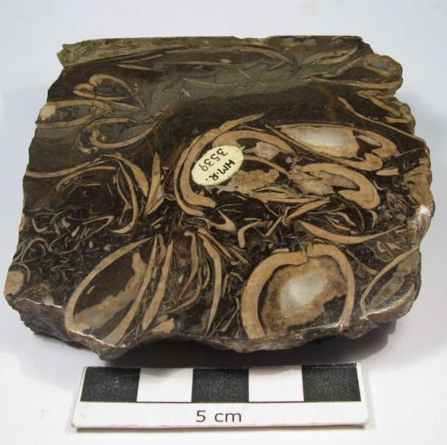
2) Ironstones
Continuous sedimentary beds – extend 100’s km
Mostly shallow near-shore marine sediments
  Shallow-oxidising Ores:Goethite, hematite
  Deeper-more reducing- Ores: siderite and chamosite
Iron transported in fluids and replaced calcium carbonate, fossils or oolites
Phanerozoic-type deposits
Goethite ooids in an ooidal ironstone (Lr Jurassic)
Musselband Ironstone-non-marine bivalve, Scotland

Slide 20
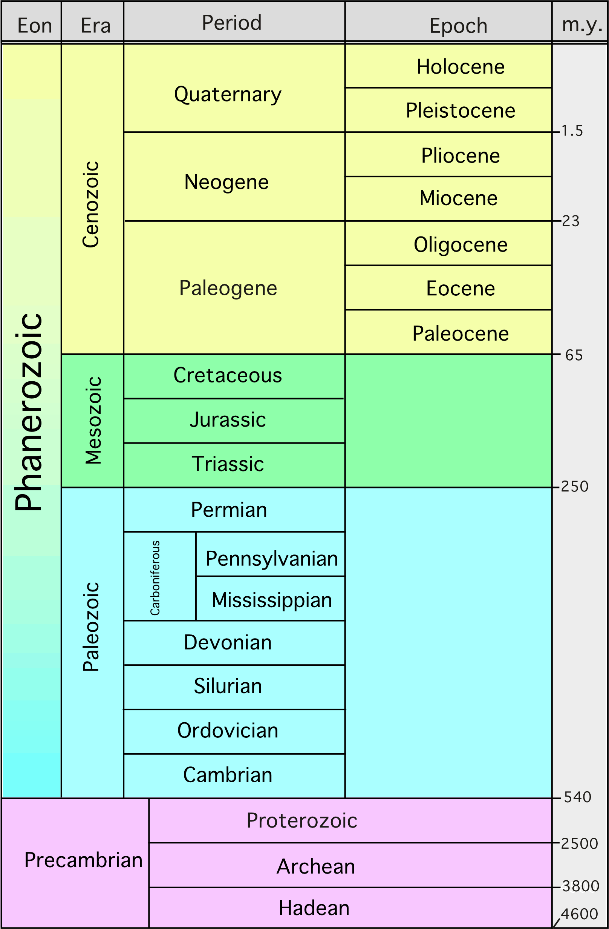
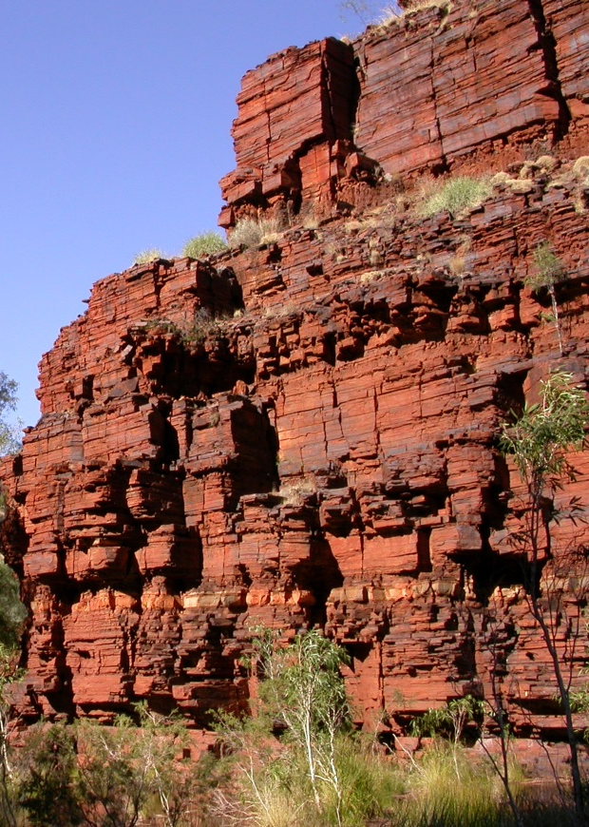
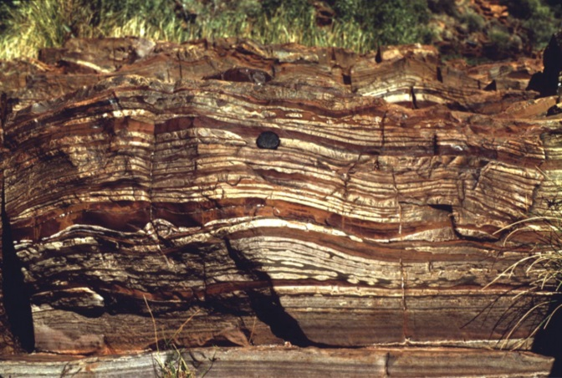
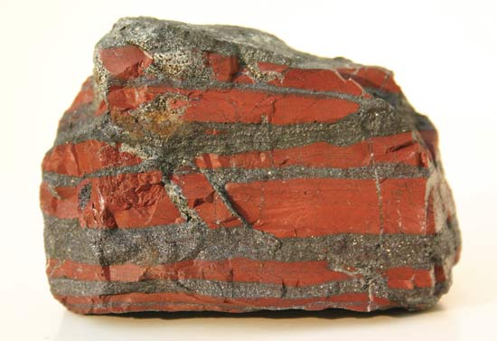
3) Banded Iron formations (BIFs)
Bulk of the worlds iron ore reserves
Grade 30-50% Fe
Occur only in Precambrian rocks 1.8-3.8 billion years ago
Large: 30-700m thick and can be 1000’s km extent

Slide 21
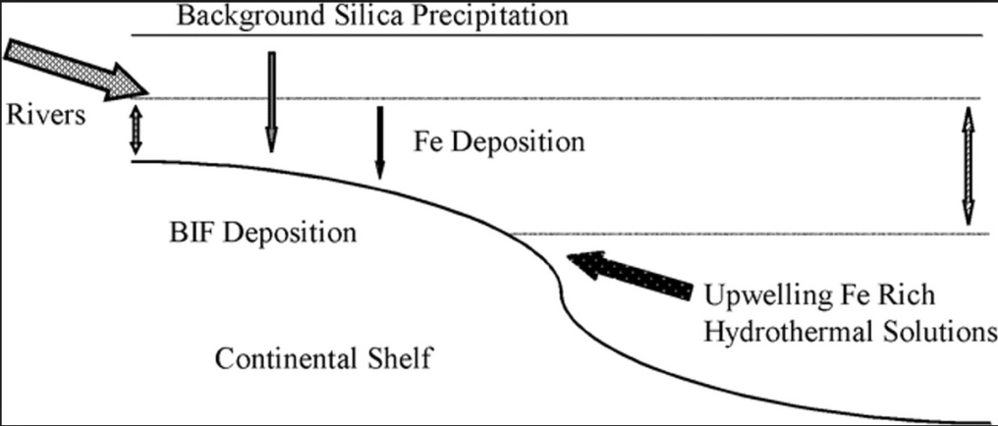
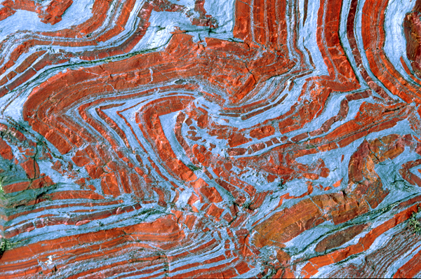
BIFs: mineralogy and origin
Origin is somewhat enigmatic
Marine basin setting
Runoff from continents of Fe²⁺ rich weathering and erosion material also from submarine hydrothermal fluids
Free oxygen was rare or absent on the Precambrian Earth
Oxygen (produced by cyanobacteria or photoferrotrophs) was combining with abundant iron in oceans of the early Earth to form BIFs
Formation of abundant BIFs stopped once the atmosphere contained more oxygen from bacterial photosynthesis
Fine-grained magnetite/ hematite with quartz, Fe silicate and Fe carbonate minerals
Later metamorphosis of most due to age
Possible model for BIF deposition
Deformed BIF

Slide 22
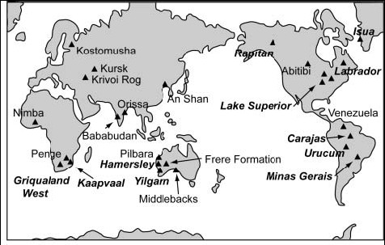
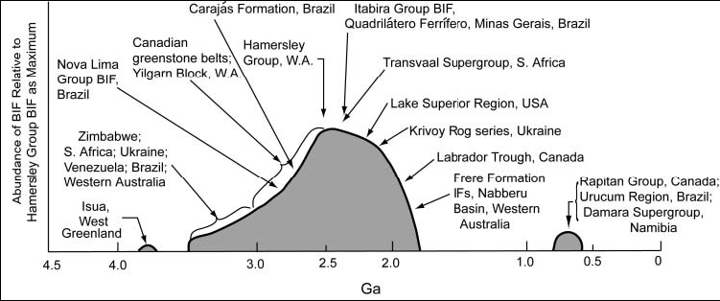
Global occurrence of Precambrian BIFs. The map emphasizes the wide distribution of BIF and shows only a selection of well-known occurrences of different ages and kinds.
Schematic diagram showing the relative abundance of Precambrian BIFs vs. time, with several of the major BIFs or major BIF regions identified.

Slide 23
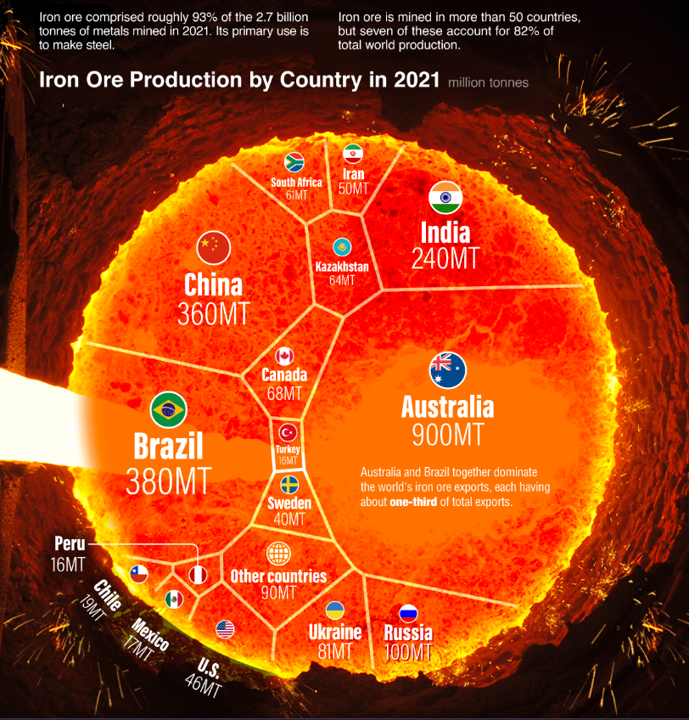

Slide 24
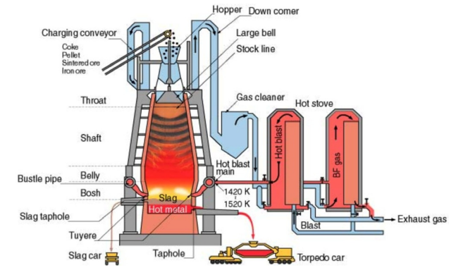
Steel making
Blast furnace processes

Slide 25
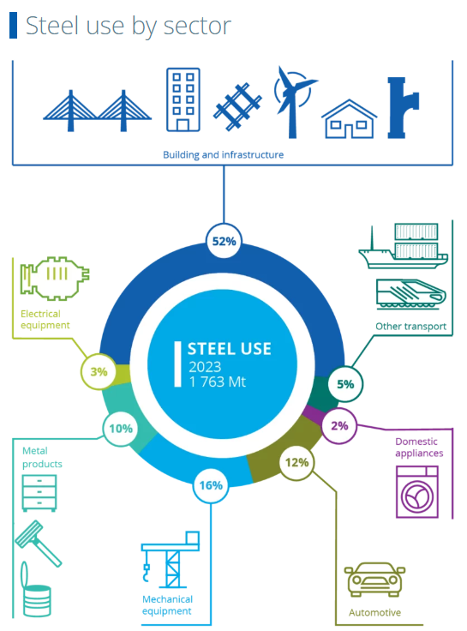
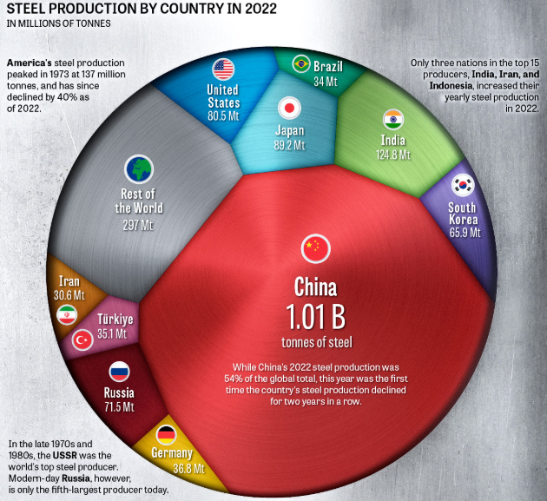
World Steel Association

Slide 26
Summary -Fe
Worlds reserves are widespread and critical to the steel industry
2.3+ million metric tons of iron ore produced per year
3rd most abundant element
Deposits formed through igneous, sedimentary and metamorphic activity
Main ore minerals are magnetite and hematite
Main ore deposit are Banded Iron Formations (BIFs) which are Precambrian in age

Slide 27
BATTERY ELEMENTS

Slide 28

Learning outcomes
Explain Li-ion battery technology
Discuss key battery elements:
  Manganese
  Aluminium
  Nickel
  Copper
  Cobalt
  Lithium
Geological settings of ore deposits
Mineralogy of ore deposits
Production of the pure material

Slide 29
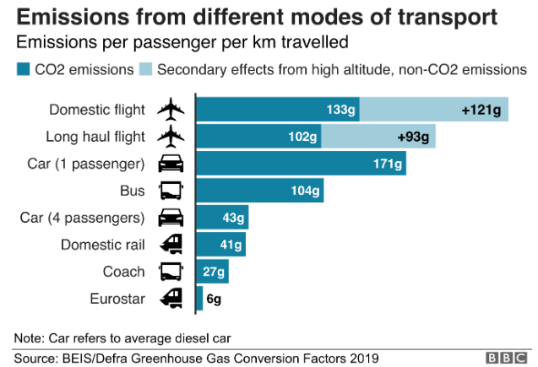
UK: All new cars and vans will need to be 100% zero emission by 2035. And no new petrol or diesel cars will be sold after 2030
UK Government (DfT) December 2024

Slide 30
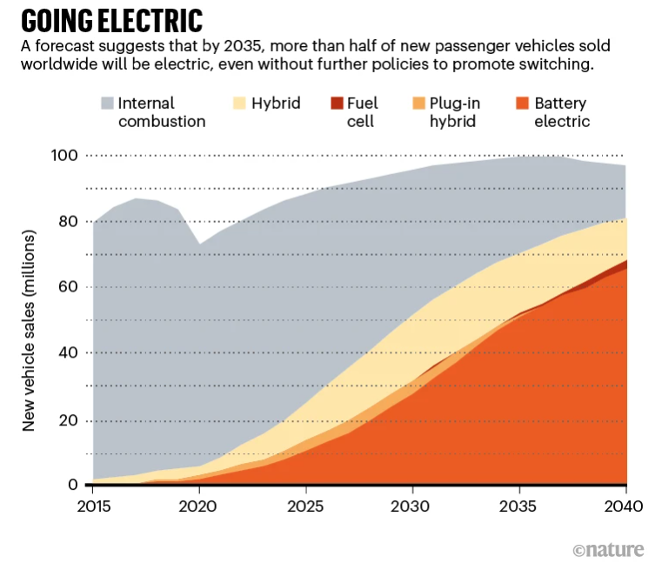
But what is in an electric car battery?
https://www.nature.com/articles/d41586-021-02222-1

Slide 31
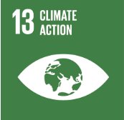

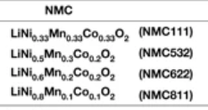
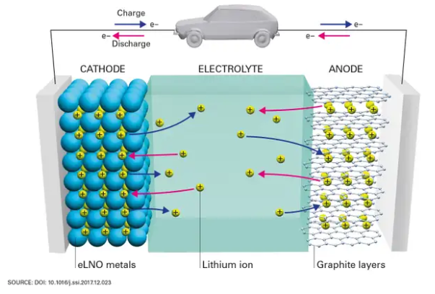
Batteries
Layered lithium cathode material is key
Added:
  Nickel increases energy density but decreases stability
  Cobalt helps stabilise the Ni
  Manganese and Aluminium can also help stabilise Ni but not as effectively
Use copper and aluminium collectors to cycle charge

Slide 32
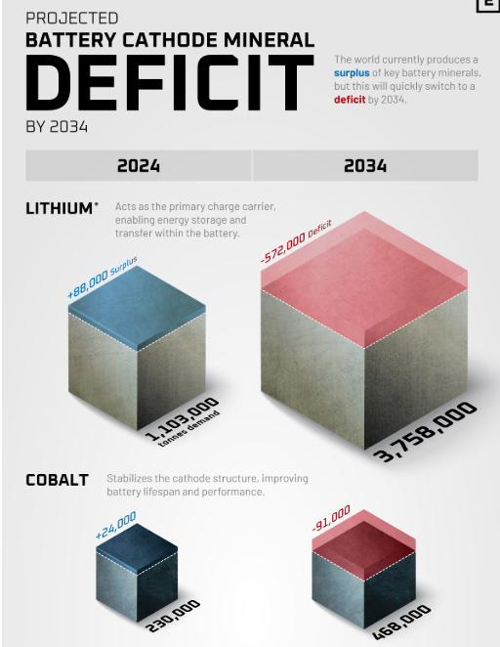
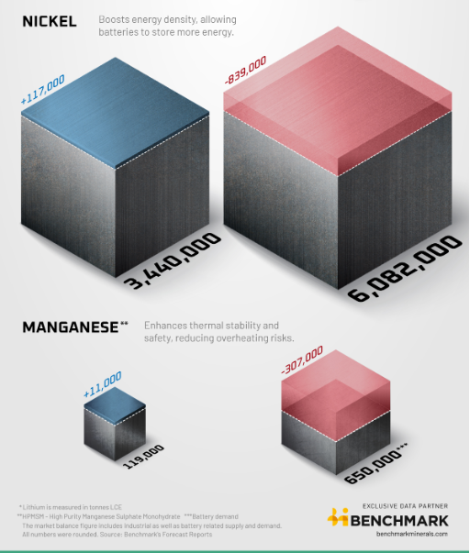
https://www.benchmarkminerals.com/

Slide 33
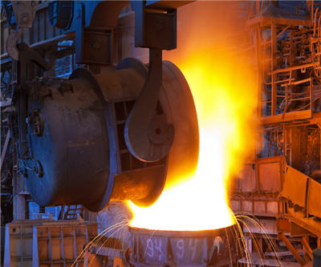
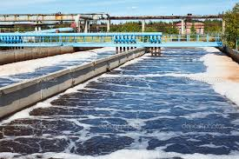
Manganese
Crustal abundance 0.095%
90% of mined manganese used in the iron and steel industry
Mn added to smelting as ferromanganese
  Scavenger of impurities e.g. sulfur and oxygen
Water treatment and purification
Key component of a lithium cathode battery

Slide 34
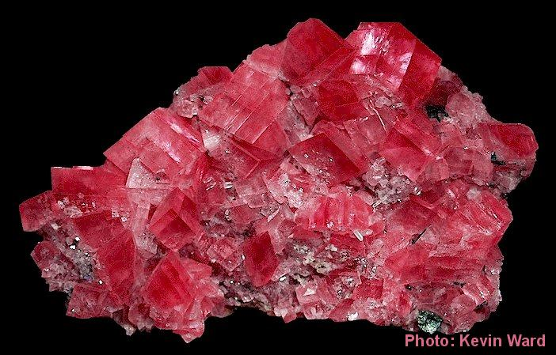
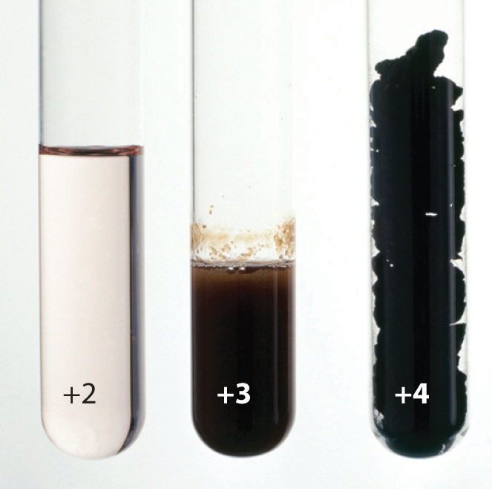
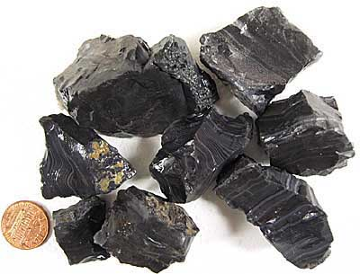
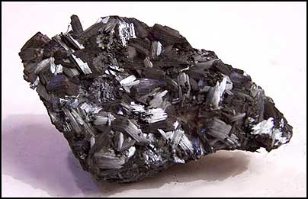
Mn chemistry and minerals
Exists in nature in different oxidation states
Minerals
Rhodocrosite
MnCO₃
Psilomelane
BaMn₉O₁₈.2H₂O
Pyrolusite
MnO₂

Slide 35
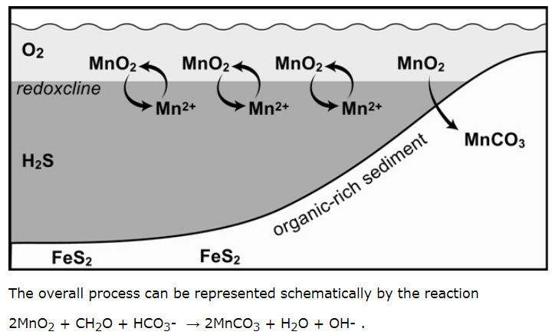
Sediment-hosted Mn ore deposits
Notes:
Manganese ore deposits, all dating from the Oligocene, form an arc around the north side of the Black Sea, stretching from Turkey through Bulgaria, the Ukraine, Russia and Georgia and finally in Kazakhstan. They constitute the third great episode of Mn deposition, in the Early Oligocene.
Black Sea deposits (click for larger image). Not shown is Mangyshlak in Kazakhstan.
Table of average ore compositions
These and most other large Mn deposits likely formed around the margins of euxinic basins (those with free H₂S in deep water). Such basins -- exemplified by the modern Black Sea -- have a thin zone of oxygen-containing water overlying a large reservoir of oxygen-free, sulfidic water. Elements like Mn that are soluble under reducing, sulfidic conditions but insoluble under oxidizing conditions precipitate along the interface between these water masses. Generally the Mn solids simply sink back into the sulfidic water and redissolve, but along basin margins, where the transition impinges on the bottom, Mn oxide accumulates in the bottom sediment where it reacts with organic matter to form Mn carbonate (Force and Cannon,1988; Okita, 1987; Okita et al. 1988; Maynard et al., 1990; Okita 1992, and Okita and Shanks, 1992).
The overall process can be represented schematically by the reaction
2MnO₂ + CH₂O + HCO₃- → 2MnCO₃ + H₂O + OH- .
1/2 the C incorporated in the MnCO₃ comes from organic matter, which has an isotopic composition of ~ -27 permil, while the remaining 1/2 comes from oceanic HCO₃ with an isotopic composition close to 0 permil.
The resulting Mn deposit will have a good correlation between Mn grade and d¹³C with high grade samples approaching -15 permil.
http://www.sedimentaryores.net/Manganese/Black%20Sea%20index.html

Slide 36
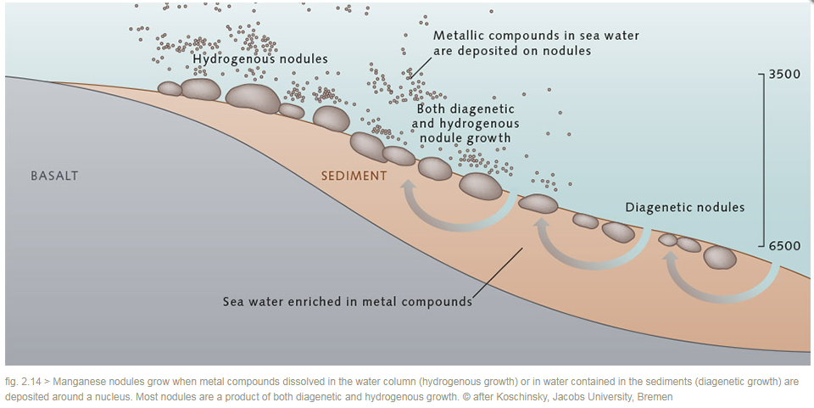
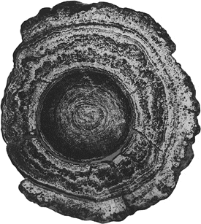
Ferromanganese nodules
For Mn-nodules need:
low sediment rates
constant flow of water
good O2 supply from ocean circulation
aqueous sediments –pore waters=diagenetic nodules
Slow growing 1mm in 1000 years

Slide 37
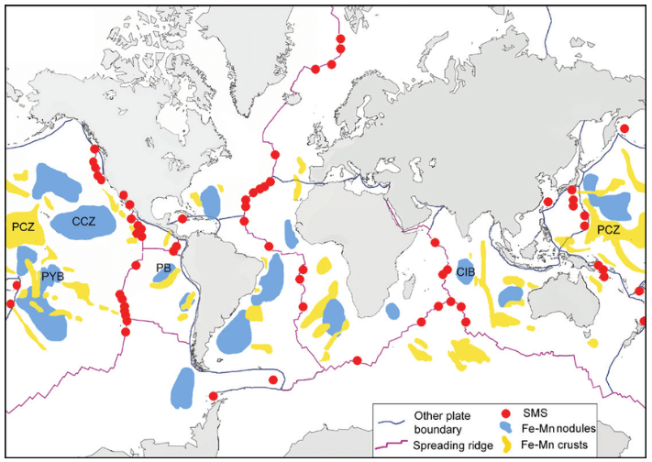

A source of critical metals
-Rare Earth Elements

Slide 38




Aluminium
2nd most abundant metal -8.2% of crust
Weighs only 1/3 that of iron or copper
Useful properties to make it easy to machine and cast
  Corrosion resistant
  Conductor of electricity
Wide number of uses

Slide 39


Bauxite
Soils rich in Al that form in hot, wet subtropical and tropical environments
Bauxite -aluminium ore
Pisolitic texture
Most deposits are younger than 60 million years
Can extend laterally over large areas
Enriched in Al to ~35%

Slide 40

Chemical weathering removes the more soluble material from aluminium-silicate rocks and leaves a residue of:
  Al hydroxides
    Gibbsite Al(OH)₃ –primary mineral in lateritic bauxite -tropics
    Boehmite γ-AlO(OH) – primary mineral in karst bauxite-Europe
    Diaspore α-AlO(OH)
  Clays e.g. Kaolinite Al₂Si₂O₅(OH)₄
  Fe oxides
  Created through weathering a soil under strong oxidising and chemical leaching conditions-lateritic weathering
+Aluminium

Slide 41

Notes:
Crushing: Bauxite ore is crushed, washed, and dried.
Digestion: The bauxite is heated in a caustic solution, usually sodium hydroxide, at high temperatures and pressures.
Separation: The hot sodium aluminate slurry is separated from the undissolved residue, called "red mud".
Precipitation: Aluminum hydroxide is precipitated from the hot solution by adding aluminum hydroxide seeds.
Separation again: The aluminum hydroxide is separated from the spent caustic liquor.
Washing and drying: The aluminum hydroxide is washed and heated to remove excess water.
Calcination: The aluminum hydroxide is heated to form alumina.

Slide 42

Requires 950°C, 150,000A and 1000V for metal reduction from the cryolite

Slide 43


Slide 44

Nickel
Nickel improves durability and corrosion resistance of steel
Ni depleted in the earths crust – 0.0072% Ni
Mafic and ultramafic igneous rocks transport Ni from the mantle- 0.1% Ni
Present in olivines and pyroxenes-substitutes for Mg and Fe
http://www.roskill.com/

Slide 45


Sulfide-Nickel Deposits
Pentlandite (yellow-white) (Fe,Ni)₉S₈
Pyrrhotite (pink-brown)
Fe₇S₈
http://pubs.usgs.gov/info/mwni_cu/

Slide 46


Sudbury, Ontario
Ni deposits formed through magmatic segregation
56 km x 26 km elliptical deposit
Conical shape-due to meteor impact
Magmatic fluids used the fractures formed during the impact to form the deposit

Slide 47



2-Residual deposits
Chemical weathering of mafic and ultramafic rocks
Hot, humid subtropical conditions
Silicates breakdown to form hydrous compounds
Ni-rich laterites
Representation of “Residual Weathering Model”
Garnierite (H₂(Ni,Mg)SiO₄

Slide 48

Nickel production
Massive sulfide deposits: Canada, Russia and Australia
Large laterite nickel deposits: Cuba, New Caledonia, Indonesia

Slide 49



Processing
https://www.smm.co.jp/en/business/nonferrous/

Slide 50



Copper
Chalcopyrite
High electrical conductivity
Easily joined and soldered
Common ore minerals include:
  Chalcopyrite CuFeS₂
  Bornite Cu₅FeS₄
  Enargite Cu₃AsS₄
Bornite
Enargite

Slide 51


Tectonic setting
http://geology.com/usgs/uses-of-copper/
Three types of deposit:
  Magmatic segregation
  Hydrothermal deposits
  Sediment-hosted stratiform deposits
Porphyry copper deposits
HYDROTHERMAL DEPOSITS
http://www.geo.fu-berlin.de/fb/e-learning/geolearning/en/mountain_building/resources/porphyry_copper_ore_deposits/index.html

Slide 52

Porphyry copper
Intrusive magma- containing ~4% water
A crust forms around the edge of the intrusion as it cools
As the rising magma cools the hot water is released
Pressure increases, steam explosions shatter the overlying rock
Escaping hydrothermal solutions carrying ore metals more along the numerous fractures and cool depositing the minerals
Fluids then continue to circulate causing alteration of the initial ore deposit

Slide 53



Bingham Pit
http://www.geomineinfo.com/mining_photos.htm
http://www.flickr.com/photos/johnbullas/2292342252/
http://earthobservatory.nasa.gov/IOTD/view.php?id=8144
http://www.geomineinfo.com/mining_photos.htm

Slide 54


Outcrops
Gossan over depleted zone
http://www.icmj2.com/03Mar/03MarFeature.htm

Slide 55






Mining & processing
http://electrochem.cwru.edu/encycl/art-m02-metals.htm
Ball mills and flotation cells
240 ton trucks
Tailings
ponds
Grade-0.25-2% Cu
+Au and Mo
http://www.flickriver.com/photos/earthworks/random/

Slide 56


Slide 57

Cu production

Slide 58


Lithium
Extracted primarily from pegmatites and brines

Slide 59



Pegmatites
Plutonic intrusions
Coarse grain size
Extended fractional crystallisation of a fertile magma
Li-bearing pegmatites are relatively rare
Greenbushes Australia is the main worked pegmatite for lithium
K(Li,Al₃)(AlSi₃)O₁₀(OH,F)₂
Granitic pegmatite

Slide 60


Continental brines
Occur in endorheic basins in areas with high evaporation rates
Cheaper and more efficient than mining rock
Key area is the central Andes –salt lakes and evaporite deposits
Source of Li thought to be the Puno-Altiplano magma body
Pumped out
Uses ~500,000 gallons of water per tonne of Lithium-env. Impact

Slide 61

Lithium distribution

Slide 62


Slide 63

Cobalt

Slide 64



Cobalt
Ore minerals include:
  Cattierite CoS₂
  Cobaltite CoAsS
  Erythrite Co₃(AsO₄)₂·8H₂O
CoS₂

Slide 65

Sediment-hosted copper deposits
Significant source of Cu
Cobalt grades in CACB vary from 0.1-1% Co

Slide 66

Formation model for
Sed-hosted Co-Cu belt deposits

Slide 67

Cobalt
Cobalt mined from
  Ni-Laterites
  Ni-sulphide deposits
  Stratiform Cu-belt deposits

Slide 68
Summary
Metals are essential for infrastructure, energy, and technology
Critical materials (e.g., lithium, cobalt, rare earth elements) are vital for the energy transition
Plate Tectonics influences resource distribution (e.g., mid-ocean ridges, subduction zones)
Key ore forming processes often involve precipitation from fluids
Growing demand for battery elements (Li, Ni, Co, Mn, Cu)
Wide range of ore deposit types, many host more than one economic metal

Slide 70

PAPER OF THE WEEK

Slide 71


The Raw Material Challenge of a Green Economy
Transition to a low-carbon economy demands significant mineral resources
Despite recycling efforts, new mining is necessary to meet demand.
Global mineral consumption will continue rising beyond 2050.

Slide 72

Can Recycling or Waste Recovery Deliver Everything We Need?
Notes:
Recycling and reprocessing of waste are essential but insufficient.

Slide 73

Challenges and Solutions in Mineral Supply
Current mining lead time (~16 years) is too long to meet demand.

Slide 74


Slide 75
A Sustainable Mining Future
Ethical and environmental concerns must be addressed.
Concept of ‘cradle-to-cradle’ mining to ensure net-positive impact.
Responsible mining can support the UN Sustainable Development Goals.
Balance between terrestrial and ocean mining must be considered.

Slide 76
Discussion question
What are the biggest challenges in securing a mineral supply for a low-carbon future?

